Slide 1
LESSON THREE
TOPICS: HOW TO LAY OUT AN ALICE WORLD, AND HOW TO FIX OBJECTS SO THAT YOU DO NOT ACCIDENTALLY MOVE THEM WHILE YOU ARE EDITING YOUR ALICE WORLD.

Slide 2
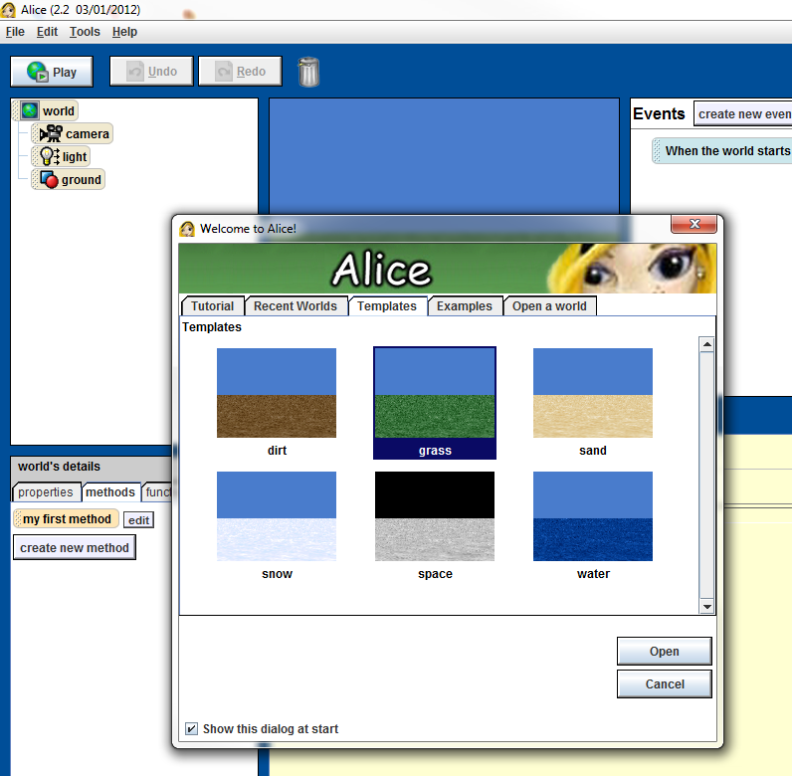
Step 1: Create a New Wold
Create a new grass world.

Slide 3
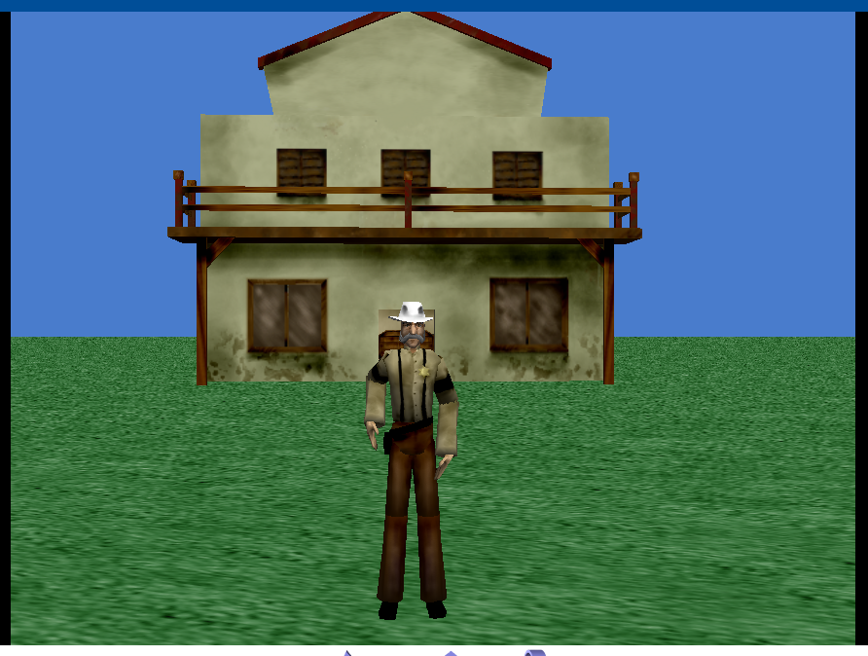
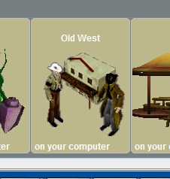
Step 2: Start Setting up Your Alice Wold
Add a Sheriff and a Saloon, from the Old West Library, to the world using the “add instance” method, see Lesson One.

Slide 4
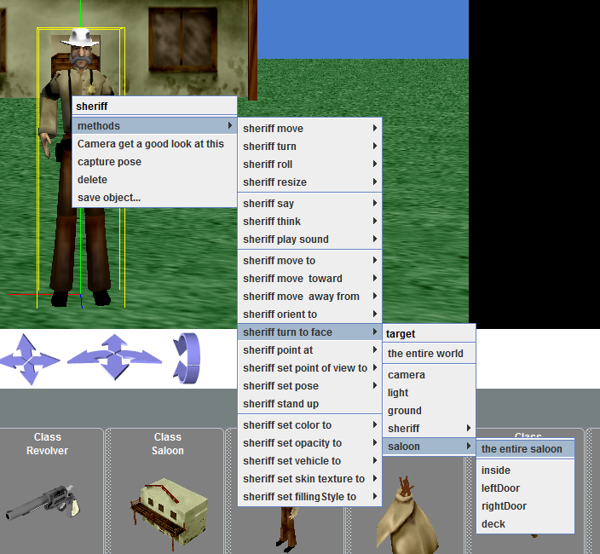
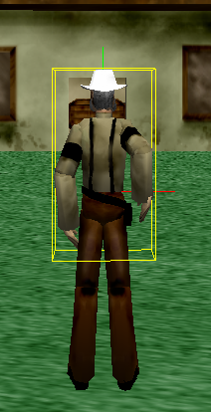
Step 3: Look at the Saloon
Right click on the sheriff, and navigate to the “turn to face” method. Then select “the entire saloon.”

Slide 5
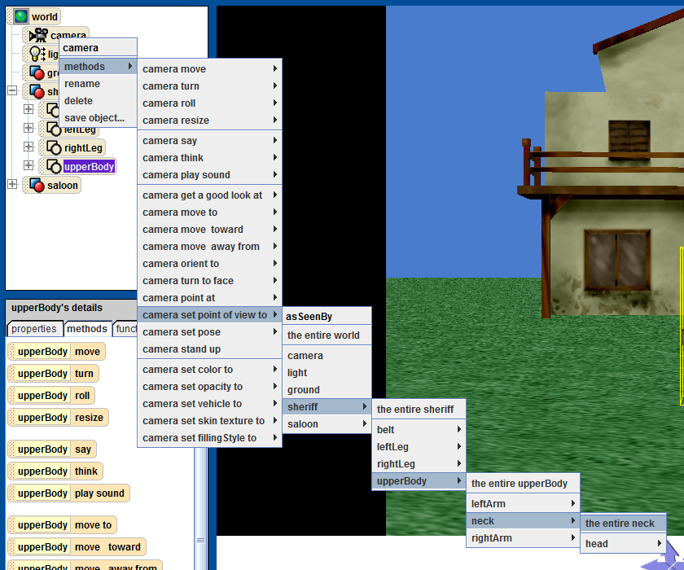
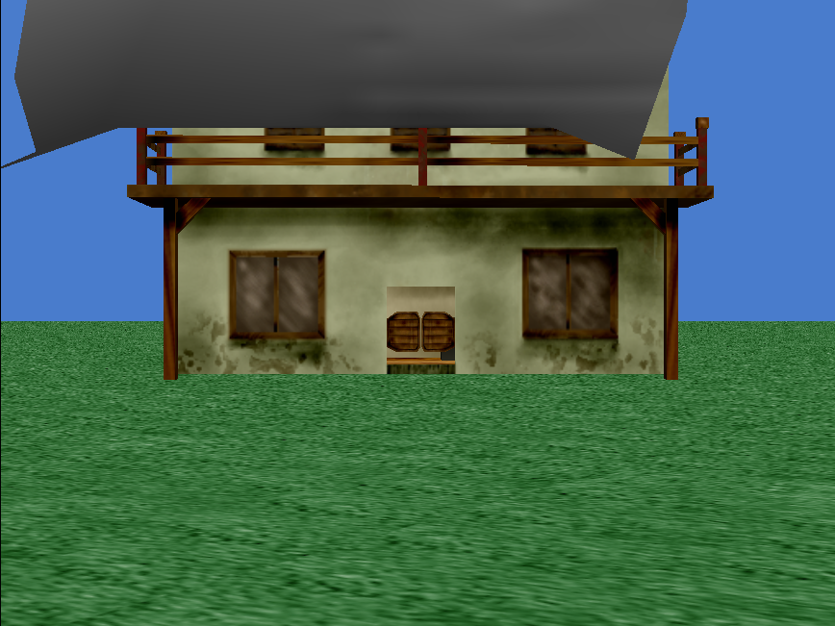
Step 4: Create the Heads Up Display (HUD)
Right click on the sheriff. Select the method “set point of view to,” and then select “the entire neck” from the sheriff object. This will move the camera to just underneath the sheriff’s mustache
Notes:
Point out to the students that the command tree associated with each method follows the same structure as the object tree in the object window.

Slide 6
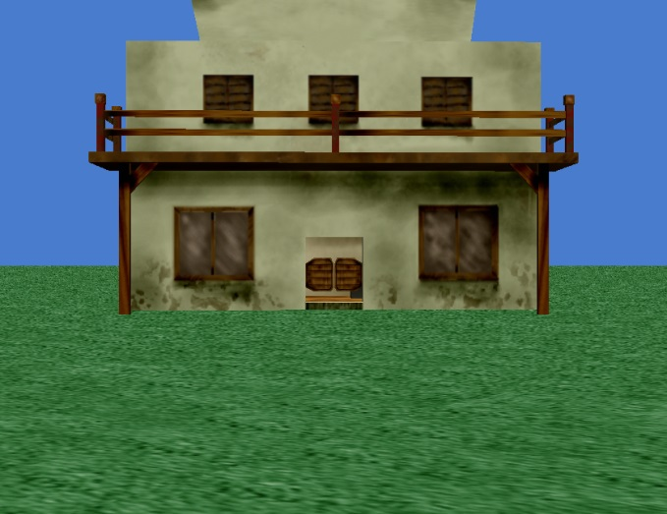

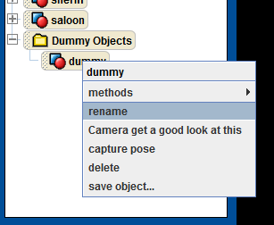
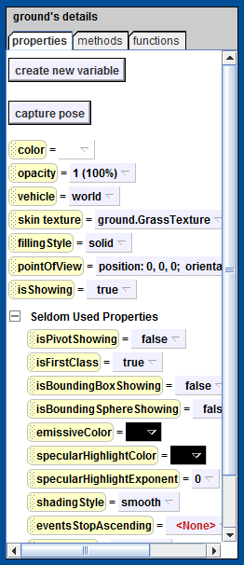
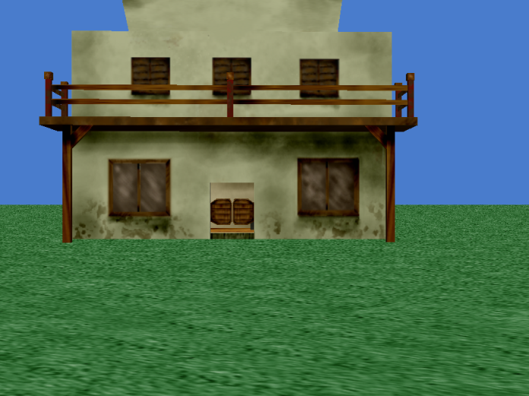
Step 5: Find the Perfect Location
Use the object methods to move the camera forward 0.2units.
Use the “move objects freely” option to move the saloon slightly to the left
Drop a dummy object at the current camera position.
Rename the new dummy object “Player View”
We need to tell Alice to not allow the ground, the Saloon, or the sheriff move if while we are adding objects to our Alice world. To do this:
Under the ground’s properties, expand the “Seldom Used Properties” option.
Find the “isFirstClass” option.
Set the value for the “isFirstClass” to false.
Notes:
After they set the “isFirstClass” property to false, ask the students to try and move the ground. If it still moves one of two things could be going on: a) they didn’t do it right, b) Alice is really buggy.
Ask the students why they might want the ground, or other models, to be fixed in place. (Remember, we can always move objects programmatically.)

Slide 7
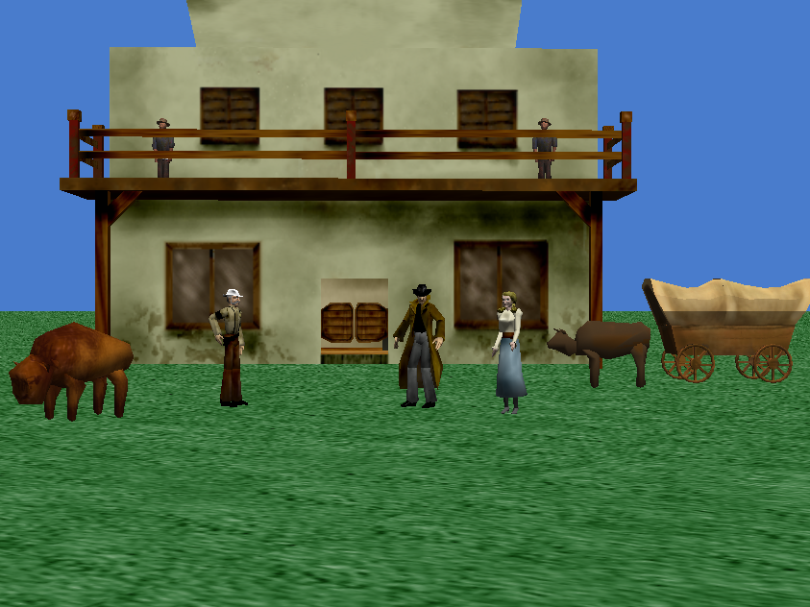
Step 6: Finish the Scene
Fix the saloon and the sheriff, as we did with the ground, so that they will not move if you click on them while you are adding objects to you Alice world.
Finish the shooting gallery scene by adding a buffalo, a cowboy, two men, another sheriff, a WagonWithOx, and a WestGirl model to your Alice world. The final shooting gallery scene should look like the picture to the right.

Slide 8
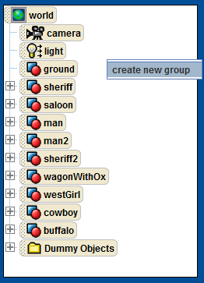
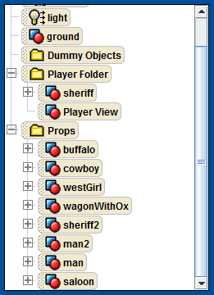
Step 7: Organize Your Object Tree
Right click in the object tree panel to create a new group. Name the new group “Player Folder.”
Drag-and-drop the Player View and the first sheriff into the Player Folder.
Create another group and name it “Props.”
Drag-and-drop the remaining models into the Props folder.
Notes:
Ask the students why they want to organize the models in the object tree? Answer: so that it is easier to see what you are working with. Tell your students if they do not organize their object tree, and there are too many objects under the root, or in one location, then you may not be able to help them debug their Alice world.

Slide 9
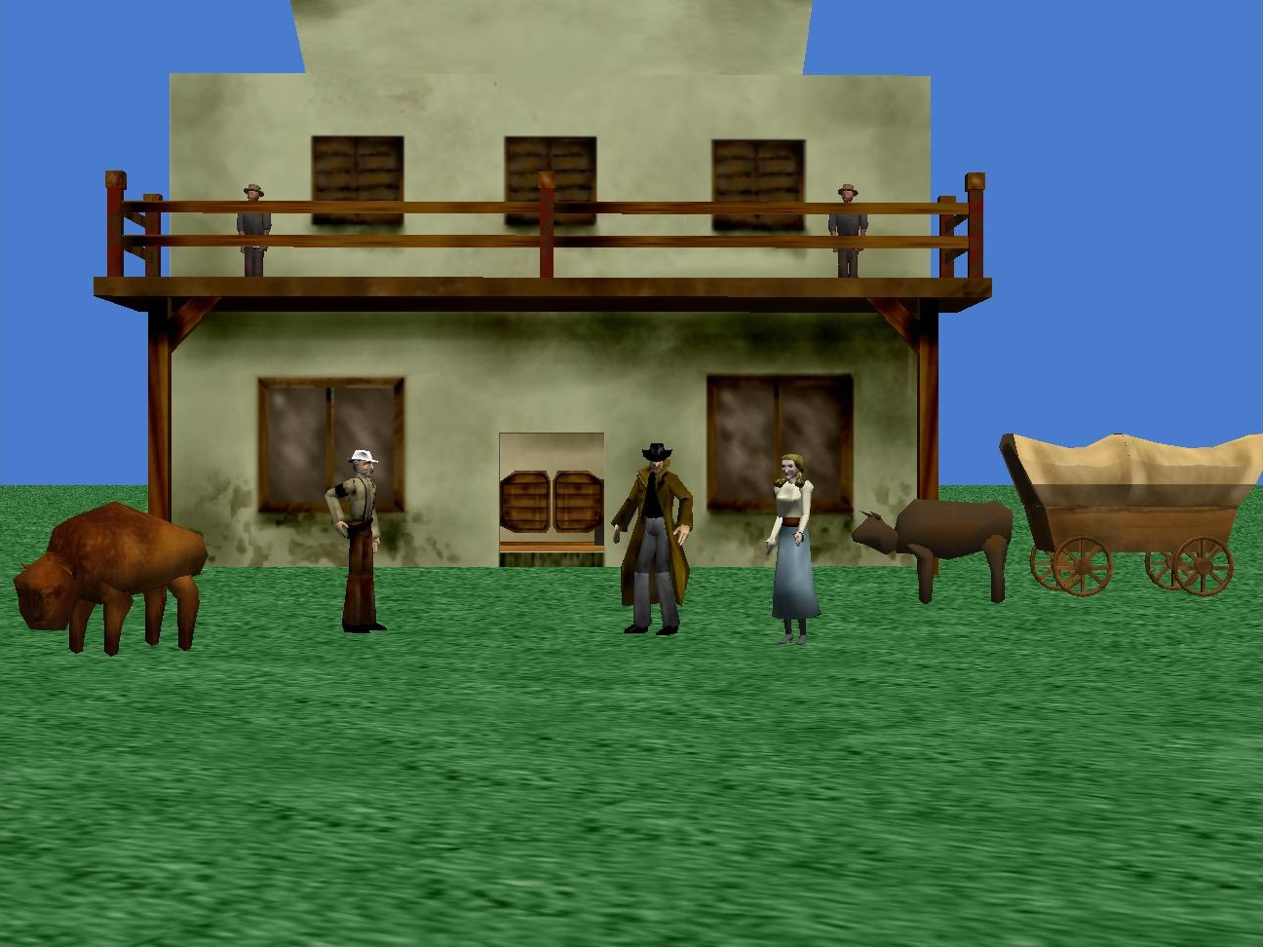
Final Scene

